Slide 1
AR Mobile Application
Course: DVA232
Group: 03
Members: Max Strang, Liam Burberry Gahm, Erik Isaksson and Mika Pärssinen.

Slide 2

01
What project we chose to work with
Augmented Reality, project 02.
02
Choice of platform
Unity
CONTENTS
03
Framework & API
AR Foundation, SmartRooms Web-based API
04
Timeline of the project
Weekly goals and etc.

Slide 3
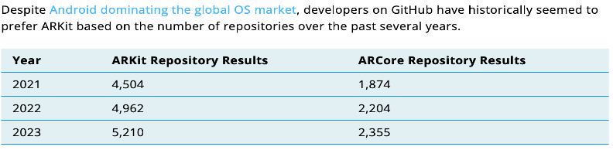
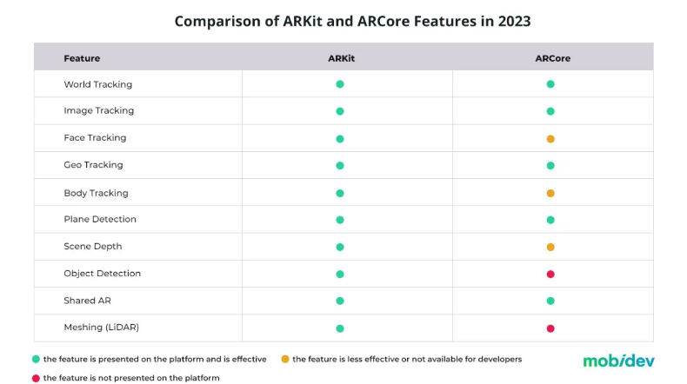
Why did we choose the project, platform, API and Framework?
PROJECT- a good challenge, could be useful when applying for jobs.
PLATFORM- Unity has more documentation and is easier to work with when placing objects and creating manuals.
Framework- Compatible with IOS. See picture
API- Built in for the Framework we chose which makes it more compatible.
Timeline, next page →

Slide 4
Week 1: Presenting the powerpoint with what we are going to use and do.
Week 2: Recognizing a object and be able to do some simple things with it, for example a button.
Week 3: Having all objects recognized and all the functionalities for those objects done.

